Slide 1
Making “As-Builts” Great Again!!
SPR 18-555: Redefining Construction “As-Built” Plans to Meet Current KYTC Needs
Roy E. Sturgill, Jr. P.E. – KTC
Steve Waddle, P.E. – KTC
Tim Taylor, P.E., Ph.D. – KTC/COE
Victoria Lasley – COE
AS-BUILTS

Slide 2
We Started with Some Questions?
Does anyone use as-builts?
What information do they need/want?
What are the benefits to producing as-builts?
What are other states doing?
Is there FHWA requirements/guidance?
We are going to find out how as-builts need to change and then build that wall! #MakingAsBuiltsGreatAgain

Slide 3
We Didn’t Like Some of the Answers
No one uses as-builts! #fakenews
We don’t have the time or manpower.
This project isn’t needed.
RESULT: A 2-year study became a 1-year study
…But now is trending to become a 2-year study
THE ART OF THE AS-BUILT
Everyone needs to read my book. Go buy it now!#TheArtoftheAsBuilt

Slide 4
We Hired the Best People…
Study Advisory Committee
Jason Siwula (KYTC)-Chair
Tim Taylor (KTC)-Principal Investigator
Erin Van Zee (KYTC)
Joe Tucker (KYTC)
Matt Looney (KYTC)
Joe Gossage (KYTC)
Jeremy Brickey (KYTC)
Michael Loyselle (FHWA)
Steve Waddle (KTC)
Victoria Lasley
Donald Trump-The POTUS
Steve Waddle is the worst. He is the biggest loser of all time. Steve Waddle is helping us! #WaddleIsForAsBuilts

Slide 5
We Established Our Primary Objectives
Synthesize Current As-Built Practice at KYTC
Investigate Other DOT Approaches & FHWA Guidance
Determine KYTC’s As-Built Needs
When will all the haters out there realize that we need Russian involvement for creating accurate as-builts! #RussianInvolvementInAsBuilts

Slide 6
We Conducted KYTC End User Interviews
Structural Design
Bridge Maintenance
Geotechnical Branch
Pavement Design
Highway Design
At this point North Korea is completing more as-built plans than us #DennisRodmanIsMakingAsBuiltsGreatAgainInNK

Slide 7
Structural Design & Geotech Interview
Rehab Designs are very difficult without foundation as-builts.
Pile lengths are vital
Potential structure/foundation reuse can save $$$
We need to support section offices to complete as-builts
Resistance is futile…wait..what?
We should probably build a wall around Structural Design. They seem very smart, a little angry, and scary as hell! #RecallTheBorgFromStarTrek

Slide 8
Bridge Maintenance
We Need Pile Driving Logs
We Need X-dimensions
We Could Really Use Concrete Cylinder Break Data
With this information scour analysis & bridge load ratings wouldn’t have to be based on the most conservative conditions!
Are X-Dimensions that place the Ninja Turtles talk about?…No! Don’t be Stoopid. #TMNT

Slide 9
Pavement Design
Need Modified Typical Sections
Would like Actual Pavements Used, Thicknesses, and Stabilizations Used
Less forensics saves $$$
Would be nice to use them for verification (ADA, etc.)
Can’t find them (5-15 year old projects); confidence in accuracy is low
ProjectWise is the most stupendous storage system known to man! Russia also has access. #UseProjectWiseCoryWilsonD7D6

Slide 10
Highway Design
Statewide LiDAR, Google Earth, etc. has made As-Builts obsolete for our needs
Other areas need them more-definitely needed for ROW
Are their costs warranted?-Just make sure they are useful.
The POTUS and team are on the job. #MakingAsBuiltsGreatAgain

Slide 11
We Investigated Current Guidance & Research
Construction Memos No. 69 & 71
Bulletin 2503.
FHWA does not really have as-built guidance
National research points mainly to new technology for creating as-builts: 3D, BlueBeam, UAS, etc.
As-built. Need. Enter Key Date. #QuitHackingMyTwitterAccountBobLewis

Slide 12
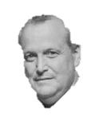
We Researched Other DOT Approaches
Multiple Approaches Exist
In-house
Design Consultant Developed
Contractor Developed
3rd Party Developed
Various Combinations
Also varying formats: from very formal and detail oriented to just the facts.
Russia Actually Has the Best As-Built Approach and Guidance. I may have a man crush on Putin #ShirtlessHorsebackRiding

Slide 13
Our Important Findings
Construction-we know there are staffing issues and winter is no longer downtime-you still may have options-RAT
The belief that As Built Information is not used and not needed by KYTC end users: #FAKE NEWS!!!
The majority of those interviewed felt very strongly that As-Built Information is very much needed
Note the emphasis on the need for Information
Mylar is no longer available. It comes from the skin of baby seals and is an integral ingredient for producing my hairpiece #MylarItIsWorseThanAButadieneShortage

Slide 14
What you can do now…
Capture information of what you can’t see after completion
Foundation as-builts
Pile Records
Pavement Structures & Stabilization Methods
Utilities
Put the information together in some rational format…something is better than nothing
Put it in the “As-Built” Folder in ProjectWise---people look
I am the most greatest of all time and can beat Michael Jordan one-on-one…#POTUSistheGOAT

Slide 15
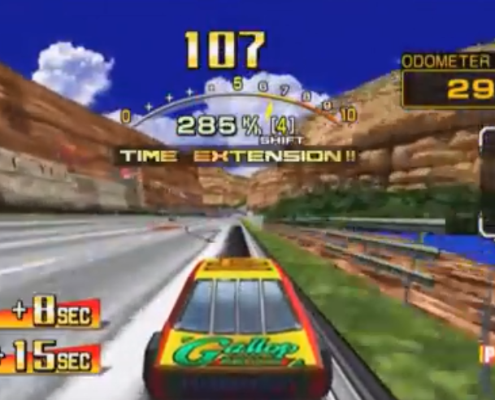
Our Next Steps
Project Extension
Determine the INFORMATION needed in as-builts
Determine the most feasible and cost effective approach to producing as-builts
Provide guidance on redefined as-builts
We are going to build an impenetrable wall and make Jason Siwula pay for it. #ProjectExtension:It’sWhatWeDoAtKTC

Slide 16
Our Next Steps
AS-BUILTS
Even Hillary says those against as-builts are “deplorable.” #ImTheReasonCovfefeIsInTheDictionary

Slide 17
If you want to help us make “As-Builts” Great Again contact our team:
Roy E. Sturgill, Jr. P.E. – roy.Sturgill@uky.edu
Steve Waddle, P.E. – steve.waddle@uky.edu
Tim Taylor, P.E., Ph.D. – tim.taylor@uky.edu
Victoria Lasley – COE

